Slide 1
_x0016_The MEX editor: METS and the Internet presentation of digitised archives
Angelika Menne-Haritz
Bundesarchiv

Slide 2
Background
Political pressure to present critical masses of digitised archives in the Internet
  Reduce the need of personal resources for repeated tasks (80% of the costs today)
  Enhance the professional control of the presentations (for higher quality)
Professional standards
  Offer contexts for understanding
  Support data sharing (European Digital Library)
Need for new tools and processes
  Integrated into the daily work of archivists

Slide 3
Digitisation policy for images from textual records
Combined strategy
  Digitisation for higher comfort for use and investigation
  Microfilm for preservation and protection of the original
Cost effectiveness
  Digital reformatting with that resolution necessary for screens and not as high as possible
Sustainability
  Preparedness for new digitisation from the same microfilm for other purposes
Notes:
So wie ein Beitrag von Steven Pugkia und Erin Rhodes (NARA) in RLG Digi News, 11/1 (15.4.2007) feststellt, dass man lange versucht war, quasi digitale Mikrofilme herzustellen, also in Auflösung und Bittiefe vergleichbare Bilder herzustellen, während die Nutzungsanforderungen andere Leistungen von Digitalisaten erwarten. In diesem Beitrag wird deutlich betont, dass bis heute Digitalisierung noch nicht als ein Mittel der Bestandserhaltung angesehen werden kann.

Slide 4
The MEX editor
Prototype product of the project <daofind>
  Midosa editor for XML-Standards (EAD, EAC and METS)
  Funded by the Andrew W. Mellon Foundation, New York
Works on the document level (finding aids) with professional terminology
Integrated HTML and print output
Platform independent (Java, Eclipse)

Slide 5
Aims of <daofind+>
Follow up of <daofind>
Aims at delivering:
  Specialised tools on the basis of prototype
  Open for all valid documents and for further additions
  To be distributed with open source license
For special archival description products:
  Finding aids for case files - basic version
  Finding aids for case files - extended version
  Finding aids for personal papers
  Finding aids for personal records
  Holdings guides
  Images viewer for integration into the finding aids

Slide 6
The prototype
Plug in for Eclipse
Three internal levels
  The standard (XML-schema)
  A definition set for a special implementation (XML-file)
  The instance (the valid XML-document)
The interface
  Different views on the XML-document (Editor, XML-file, XML-Element, HTML-List)
  Tool box for elements and sections
  A picture view for METS files

Slide 7
The definition set
Defines the needed subset of elements and attributes
Identifies the labels for the working screen for different implementations or languages
Can be changed with a special integrated tool (not public domain)

Slide 8
The role of the definition set
Level 3:
Specialised tool
- Translation into
natural language
- Defining
combinations
- Assuring validity
Level 2
(funnel):
Definition
set
Level 1:
XML-standard (schema)
Reduce the complexity by externalising standard choices

Slide 9
The MEX presentation model (1)
Three levels
  Holdings guides (short descriptions of all record groups - EAD and EAC)
  Finding aids (linked to the corresponding description in the holdings guide - EAD)
  Images combined into digital objects corresponding to the descriptive units of the finding aid (METS)

Slide 10
The MEX presentation model (2)
Two layers
  Orientation layer with selected items and structurally relevant pages
  Browsing layer for clicking through all images
  Links between both back and forth

Slide 11
The MEX presentation model (3)
A new form for the presentation of images
  Upper thirds of the pages
  Scrollable in its separate window
  All on one scrollable page (the orientation layer)

Slide 12
The principles for the use of METS
One descriptive unit in EAD = one digital archival object = one METS file
One file group contains images provided for the same purpose
The internal structure of the unit is expressed in the structural map

Slide 13
The two main components
File section:
  Click on it starts automated integration of the addresses of the image files and other metadata into the METS file
  Provides filter for the integration of data
Structural map (created automatically):
  Assignment of the presentation format (upper third / reduced size) by professional staff
  Non-standard assignment identifies the pages as selected for the orientation layer
  Adding labels for image legends

Slide 14
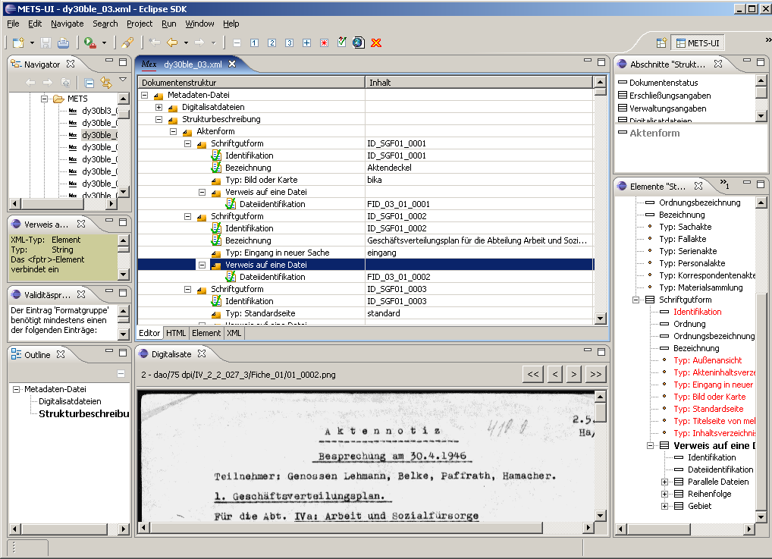
The METS-Editor
Integration of
the needed
elements with
the help of
the tool box
Synchronisation
with the picture
view

Slide 15
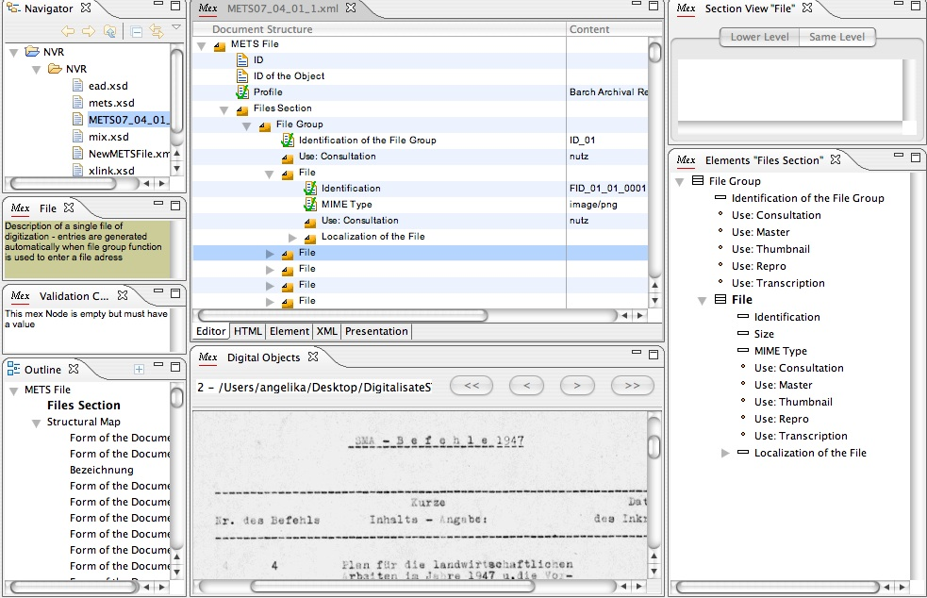
The file section

Slide 16
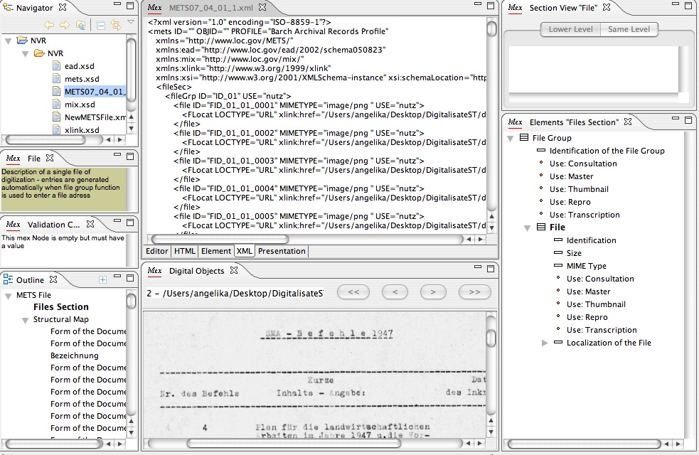
The XML-view

Slide 17
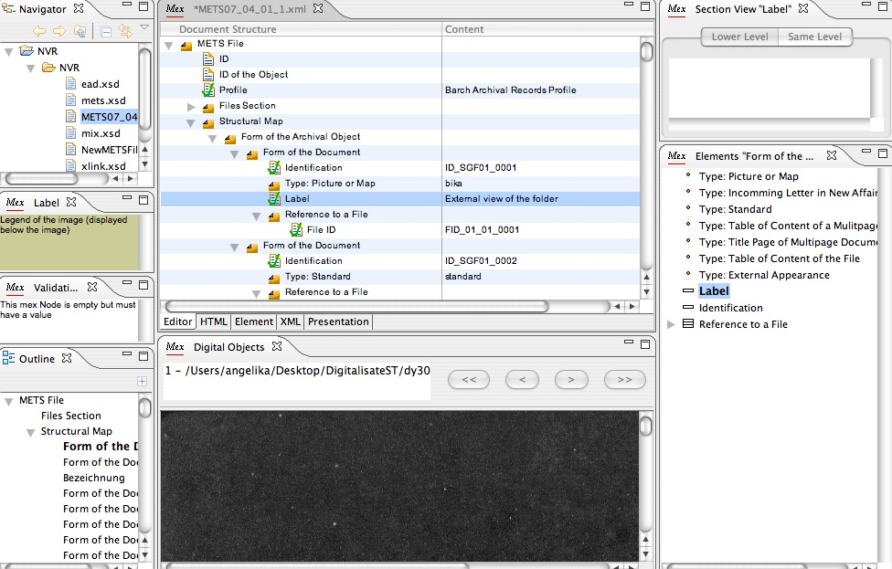
The structural map

Slide 18
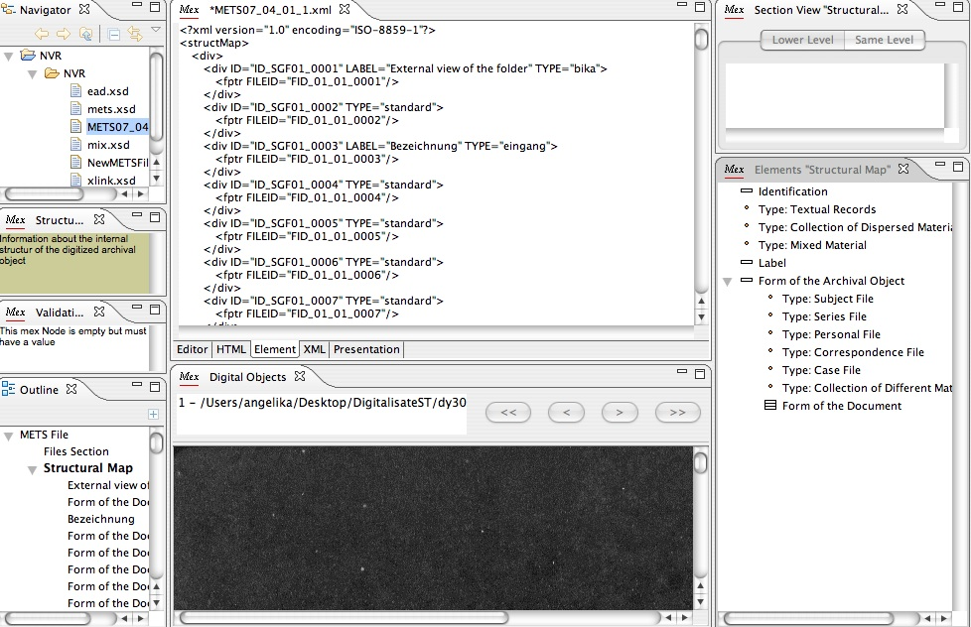
XML-view

Slide 19
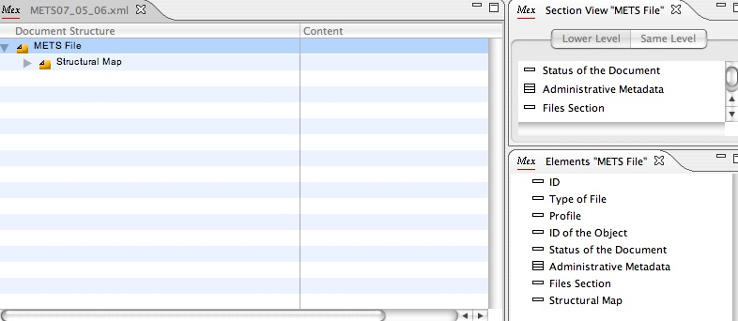
A new file

Slide 20
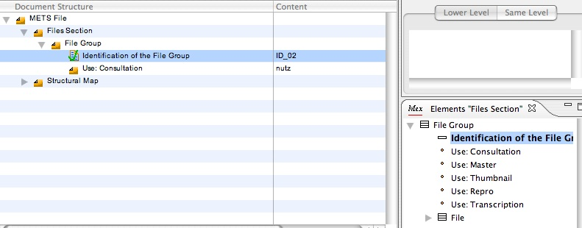
The file group

Slide 21
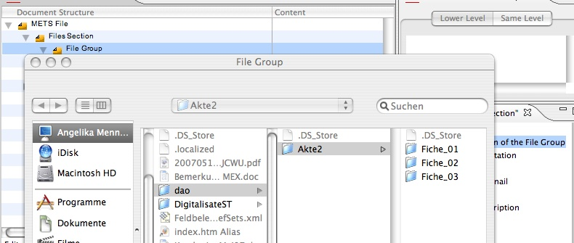
Entering images

Slide 22
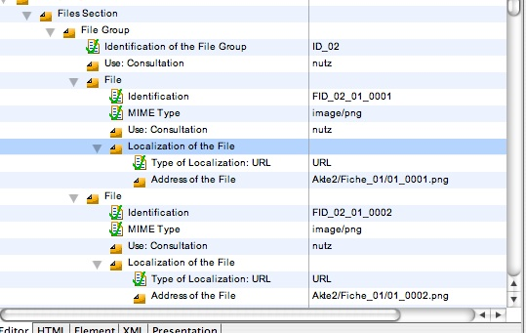
files

Slide 23
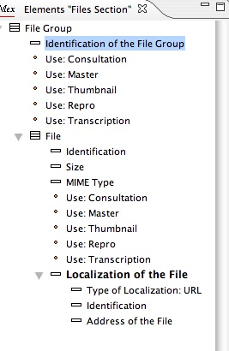
The attributes

Slide 24
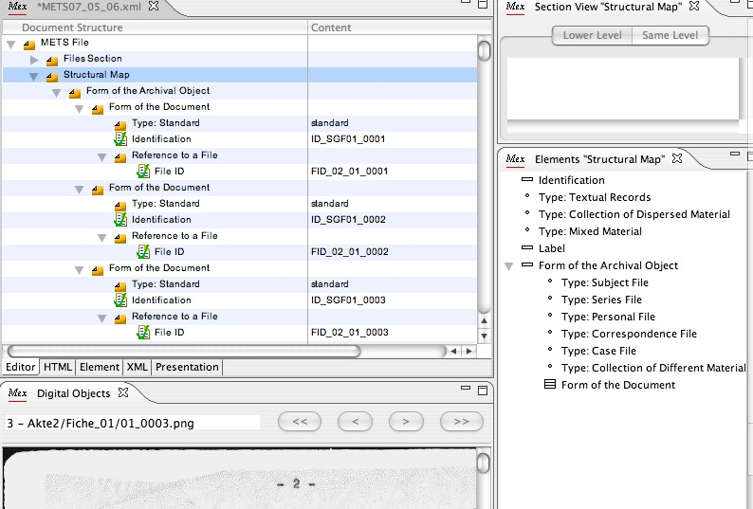
Attributes for the structMap

Slide 25
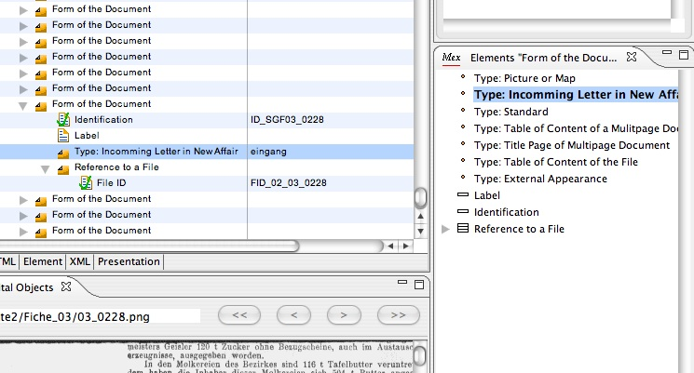
Types of documents

Slide 26
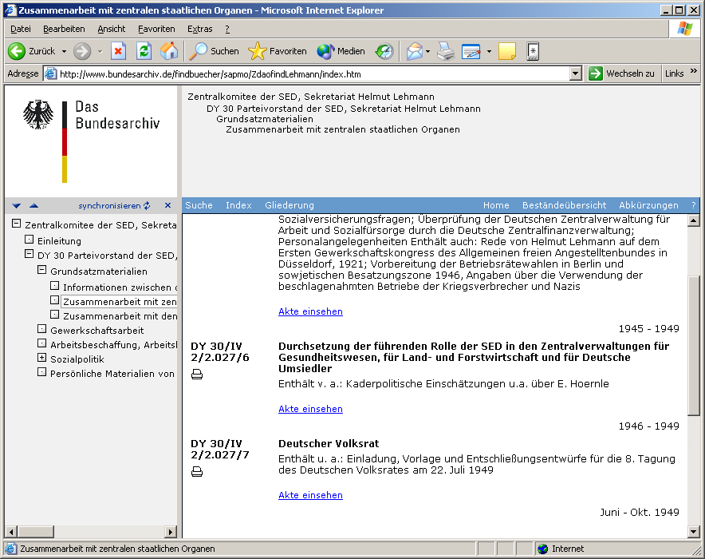
The presentation: finding aid with images
Finding aid
coded with EAD
Links to viewer
coded with METS

Slide 27
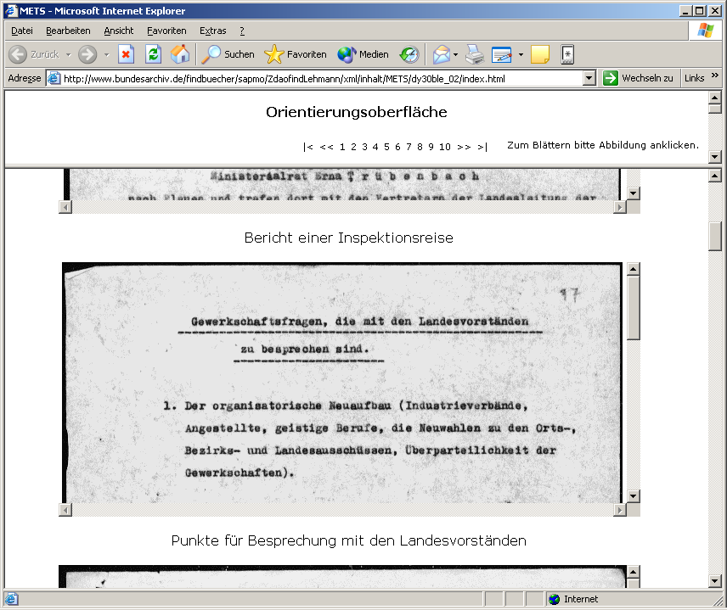
Orientation layer
display:
Upper third
of the pages
Individually
scrollable
With legend
Click leads to
browsing layer
With reproductions
in full size

Slide 28
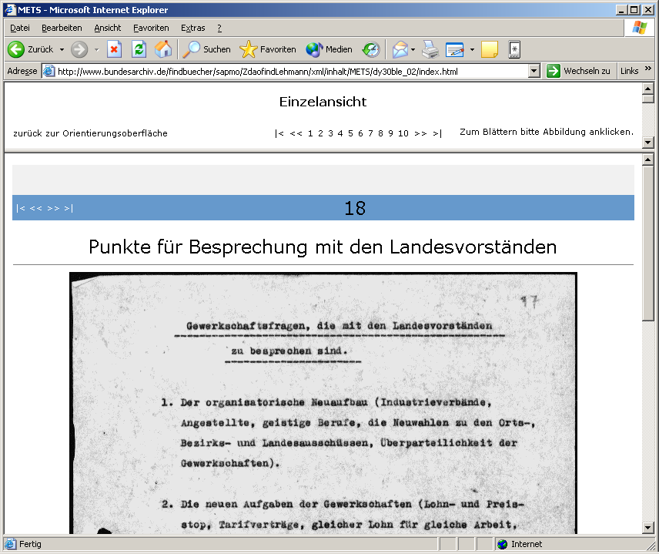
Browsing surface
To skim through
the descriptive
unit

Slide 29
Special features
Extensive use of attributes: _x000c_@use and @type with predefined values -> style sheet
Different levels inside the structMap
  1st level @type: general form of material
    selects a presentation modell of a whole record group
  2nd level <div>: form of composition (case file, action file, series)
    selects the presentation model of a descriptive unit
  3rd level <div>: form of document (incomming letter, first page of a lrger document, agenda of minutes etc.)
    selects the presentation of a page

Slide 30
Characteristics of MEX
Complete set of tools for the whole work process for presenting images in context
Combined international standards
Open for changes (f.i. other style sheets)
Open for all valid XML-files

Slide 31
Further developments
Transformation between different subsets: conversion tools for mappings and crosswalks
Integration of EAD-data into the presentation - not into the METS file
Further presentation models

Slide 32
Info:
www.daofind.de
www.instada.eu
Download of the tool
  www.daofind.de -> downloads
  www.startext.de/mex/mex-downloads

